Slide 1
Neural Networks
Gradient Descent
(The Math-y bits)

Slide 2
Re-Cap
We demonstrated that Neural Networks are capable of learning novel transformations that are highly predictive.
How do they do so?
A complicated architecture, and
Gradient Descent

Slide 3
Show of hands
Who here has taken coursework in:
Linear regression
Calc I

Slide 4
Agenda:
Machine Learning primer
Two of the elements of a machine learning model
Linear regression
Zoomed-in, in-depth example
Quick high-level, zoomed out example
Neural Network
Zoomed-in, in-depth example

Slide 5
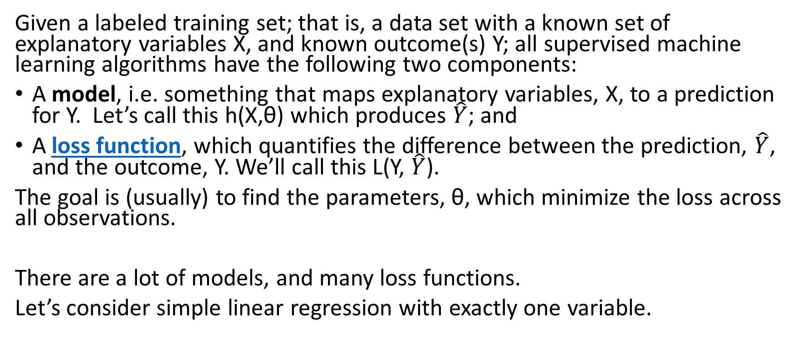
Machine learning –Supervised learning
Given a labeled training set; that is, a data set with a known set of explanatory variables X, and known outcome(s) Y; all supervised machine learning algorithms have the following two components:
A model, i.e. something that maps explanatory variables, X, to a prediction for Y. Let’s call this h(X,θ) which produces $\hat{Y}$; and
A loss function, which quantifies the difference between the prediction, $\hat{Y}$, and the outcome, Y. We’ll call this L(Y, $\hat{Y}$).
The goal is (usually) to find the parameters, θ, which minimize the loss across all observations.
There are a lot of models, and many loss functions.
Let’s consider simple linear regression with exactly one variable.
Notes:
"Loss function" might also be called "cost function", and "parameters" might also be called "weights".

Slide 6
What is the form of that model for linear regression, i.e. how do we get our y-hat (for one observation)?

Slide 7
What is the form of that model for linear regression, i.e. how do we get our y-hat (for one observation)?
$$\hat{Y}=B+W∗X$$
What is the loss function (for one observation)?

Slide 8
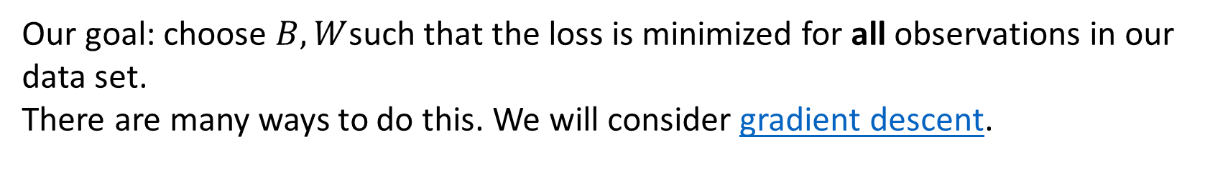
What is the form of that model for linear regression, i.e. how do we get our y-hat (for one observation)?
$$\hat{Y}=B+W∗X$$
What is the loss function (for one observation)?
$L(Y, \hat{Y})=$ ${\left(Y\text{ − }\hat{Y} \right)}^{2}$ or ${\left(\hat{Y}\text{ −}Y\right)}^{2}$
Our goal: choose $B,W$such that the loss is minimized for all observations in our data set.
There are many ways to do this. We will consider gradient descent.

Slide 9
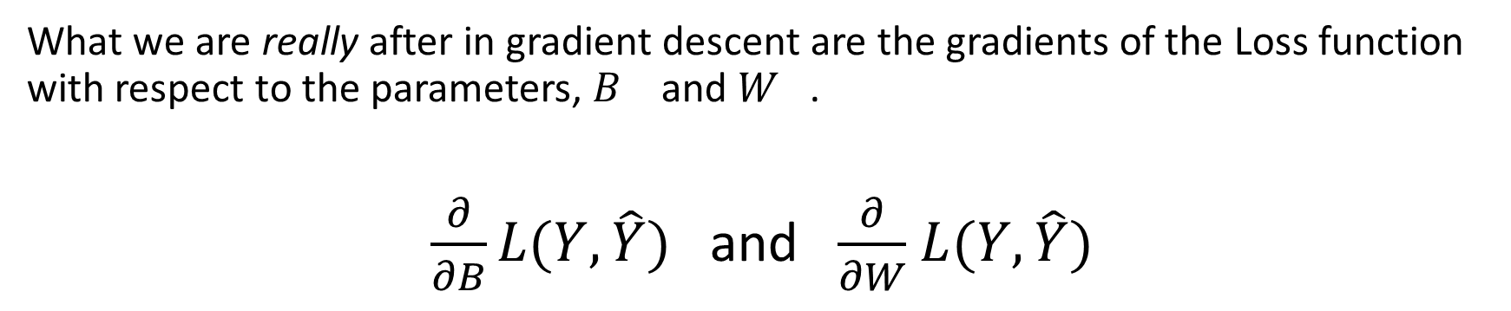
Gradient Descent
What we are really after in gradient descent are the gradients of the Loss function with respect to the parameters, $B_{}$ and $W_{}$.
$\frac{∂}{∂B}L(Y, \hat{Y})$ and $\frac{∂}{∂W}$ $L(Y, \hat{Y})$
We could easily plug and perform symbolic calculus. Instead, we’ll take a different tack and solve empirically.
Let’s consider an example.

Slide 10
Linear regression example (zoomed in)
Suppose we have an observation where x = 2, and y = 7.
What does the loss function for this single observation look like?

Slide 11
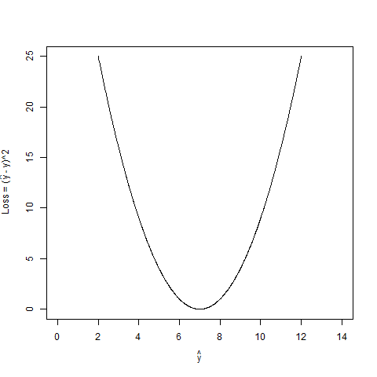

Linear regression example (x = 2, y = 7)
What does the loss function for this single observation look like?
$L(Y, \hat{Y})=$ ${\left(\hat{Y}\text{ −}Y\right)}^{2}={\left(\hat{Y}\text{ −}7\right)}^{2}$
Notes:
What is the ideal Y-hat we’re after (for this observation)?

Slide 12
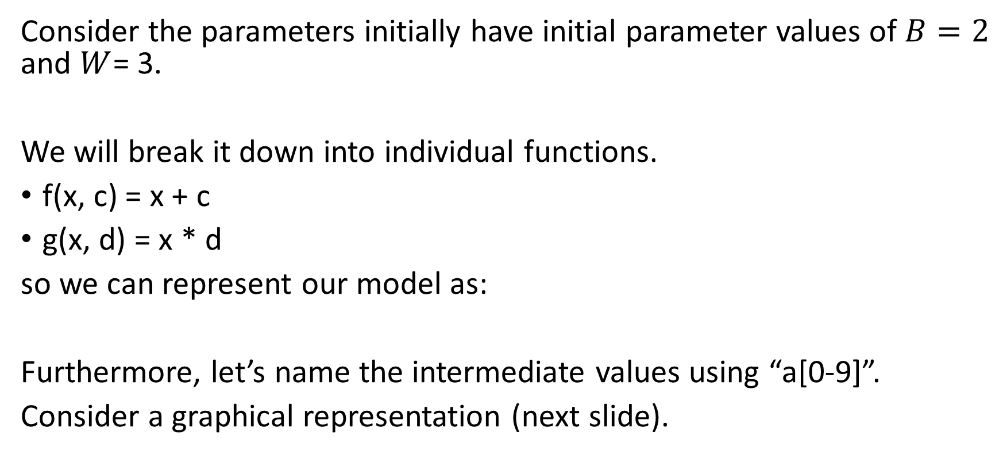
Linear regression example (x = 2, y = 7)
Consider the parameters initially have initial parameter values of $B=2$ and $W$= 3.
We will break it down into individual functions.
f(x, c) = x + c
g(x, d) = x * d
so we can represent our model as:
Furthermore, let’s name the intermediate values using “a[0-9]”.
Consider a graphical representation (next slide).
$$\hat{Y}=B+W∗X=f(g\left(X, W\right), B)$$

Slide 13
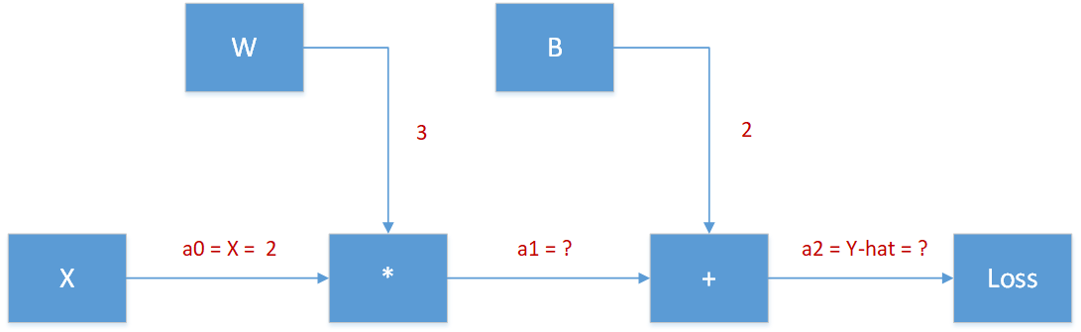
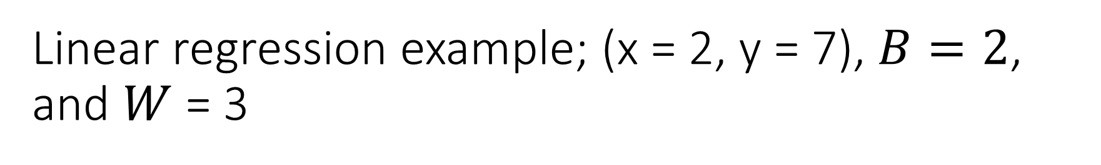
Linear regression example; (x = 2, y = 7), $B=2$, and $W$= 3
g(a0,W)

Slide 14

Linear regression example; (x = 2, y = 7), $B=2$, and $W$= 3
f(a1,B)
Notes:
I have made a point to name the values between the local

Slide 15

Linear regression example; (x = 2, y = 7), $B=2$, and $W$= 3
Now, we have a y-hat. We can pass this to our loss function.

Slide 16
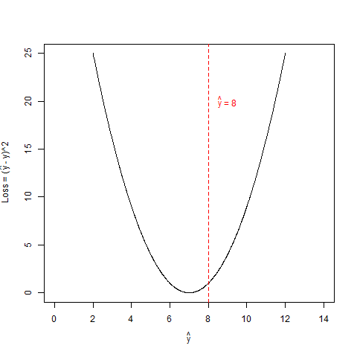
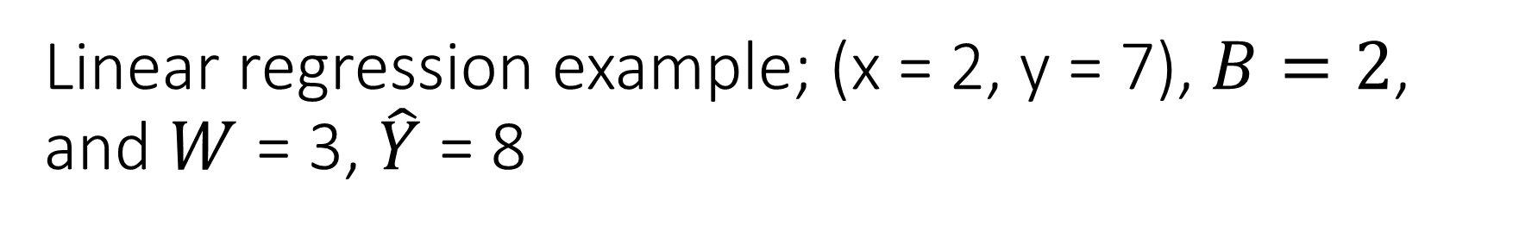
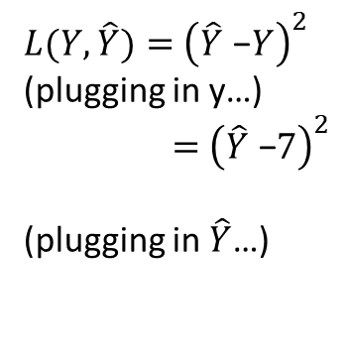
Linear regression example; (x = 2, y = 7), $B=2$, and $W$= 3, $\hat{Y}$ = 8
$L(Y, \hat{Y})=$ ${\left(\hat{Y}\text{ −}Y\right)}^{2}$
(plugging in y…)
$=$ ${\left(\hat{Y}\text{ −}7\right)}^{2}$
(plugging in $\hat{Y}$…)

Slide 17
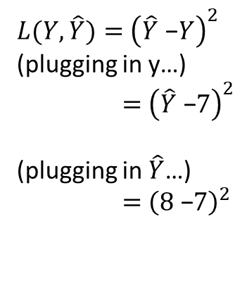
Linear regression example; (x = 2, y = 7), $B=2$, and $W$= 3, $\hat{Y}$ = 8
$L(Y, \hat{Y})=$ ${\left(\hat{Y}\text{ −}Y\right)}^{2}$
(plugging in y…)
$=$ ${\left(\hat{Y}\text{ −}7\right)}^{2}$
(plugging in $\hat{Y}$…)
$=$ ${\left(8\text{ −}7\right)}^{2}$

Slide 18
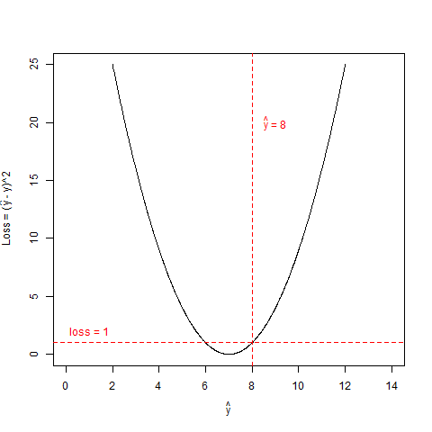
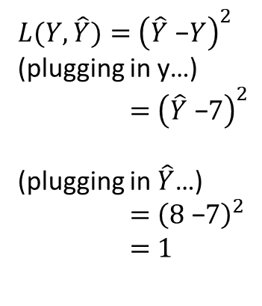
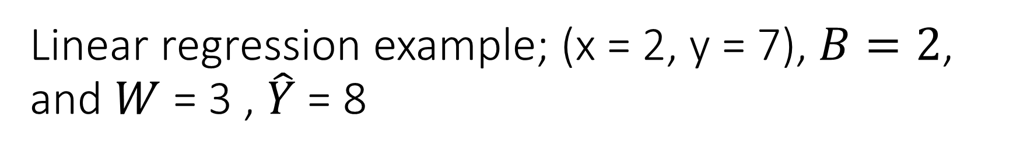
Linear regression example; (x = 2, y = 7), $B=2$, and $W$= 3 , $\hat{Y}$ = 8
$L(Y, \hat{Y})=$ ${\left(\hat{Y}\text{ −}Y\right)}^{2}$
(plugging in y…)
$=$ ${\left(\hat{Y}\text{ −}7\right)}^{2}$
(plugging in $\hat{Y}$…)
$=$ ${\left(8\text{ −}7\right)}^{2}$
$=$ $1$

Slide 19
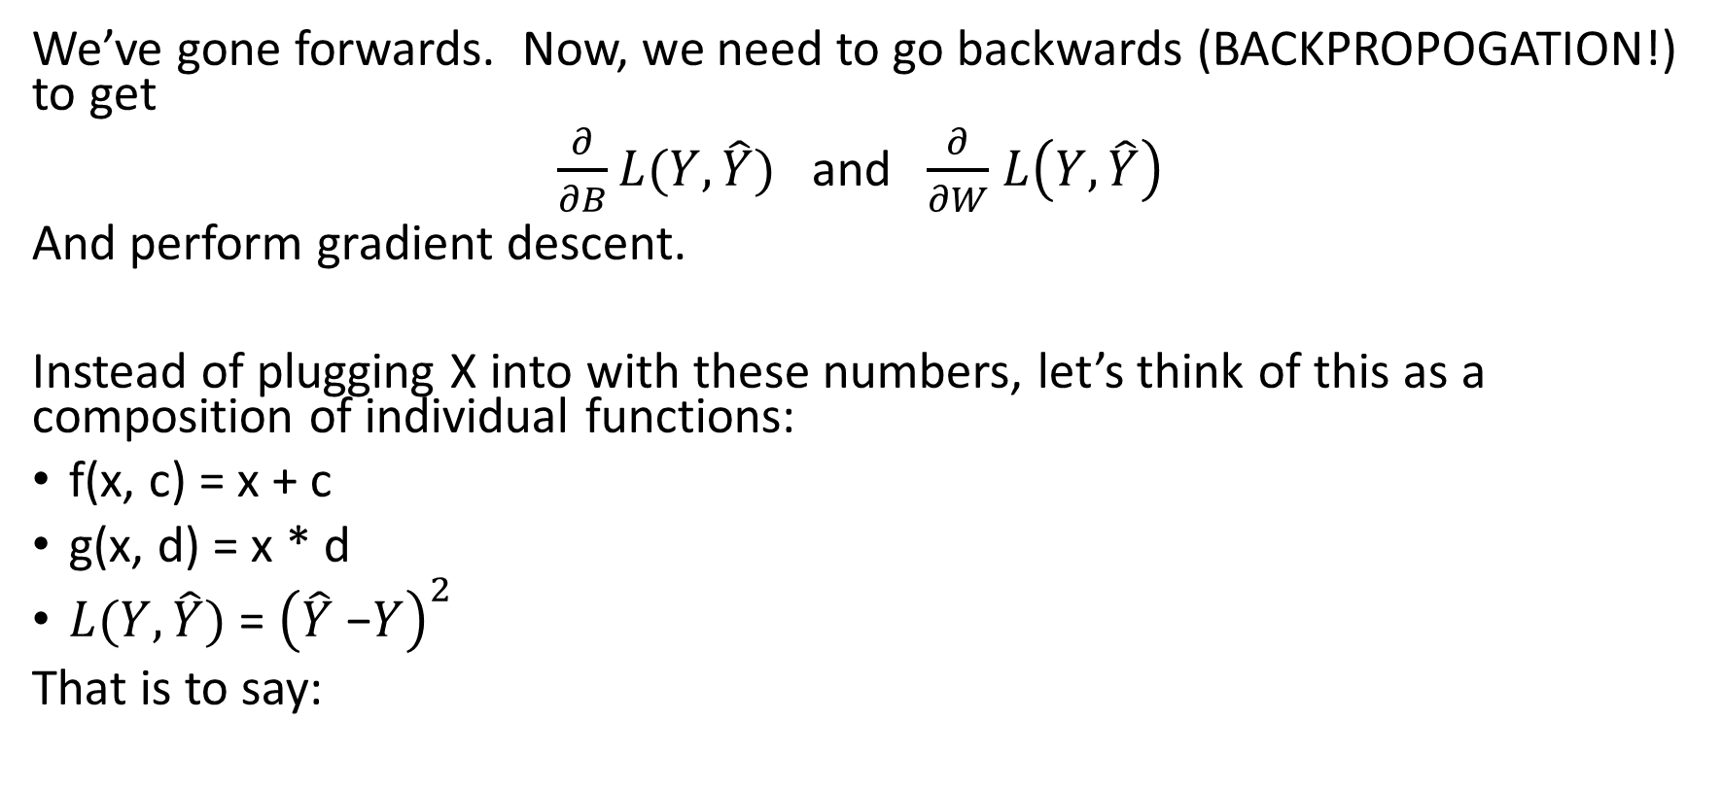
Linear regression example; (x = 2, y = 7), $B=2$, and $W$= 3, $\hat{Y}$ = 8
We’ve gone forwards. Now, we need to go backwards (BACKPROPOGATION!) to get
$\frac{∂}{∂B}L(Y, \hat{Y})$ and $\frac{∂}{∂W}$ $L\left(Y, \hat{Y}\right)$
And perform gradient descent.
Instead of plugging X into with these numbers, let’s think of this as a composition of individual functions:
f(x, c) = x + c
g(x, d) = x * d
$L(Y, \hat{Y})$ = ${\left(\hat{Y}\text{ −}Y\right)}^{2}$
That is to say:

Slide 20
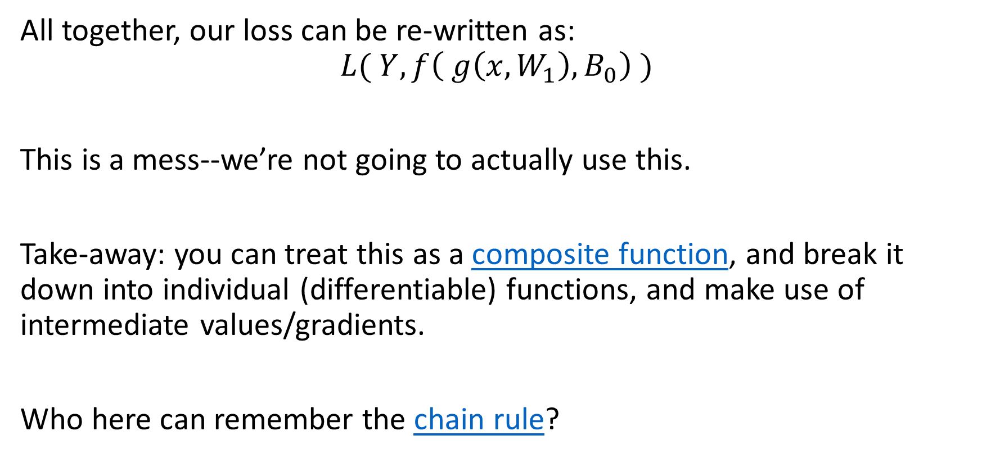
Linear regression example; (x = 2, y = 7), $B=2$, and $W$= 3, $\hat{Y}$ = 8
All together, our loss can be re-written as:
$$L( Y,f\left( g\left(x, W_{1}\right), B_{0}\right) )$$
This is a mess--we’re not going to actually use this.
Take-away: you can treat this as a composite function, and break it down into individual (differentiable) functions, and make use of intermediate values/gradients.
Who here can remember the chain rule?

Slide 21
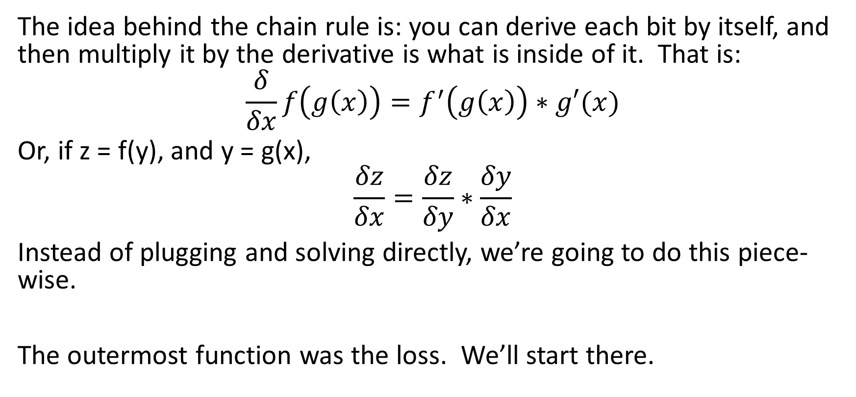
Linear regression example; (x = 2, y = 7), $B=2$, and $W$= 3, $\hat{Y}$ = 8
The idea behind the chain rule is: you can derive each bit by itself, and then multiply it by the derivative is what is inside of it. That is:
$$\frac{δ}{δx}f\left(g\left(x\right)\right)=f^{′}\left(g\left(x\right)\right)∗g′(x)$$
Or, if z = f(y), and y = g(x),
$$\frac{δz}{δx}=\frac{δz}{δy}∗\frac{δy}{δx}$$
Instead of plugging and solving directly, we’re going to do this piece-wise.
The outermost function was the loss. We’ll start there.

Slide 22
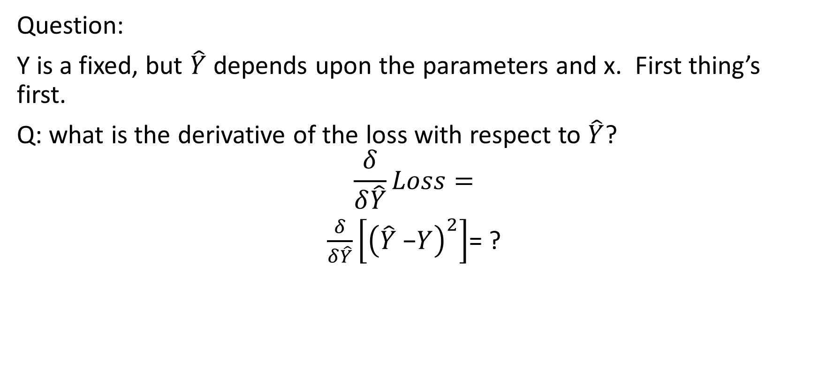
Linear regression example; (x = 2, y = 7), $B=2$, and $W$= 3, $\hat{Y}$ = 8
Question:
Y is a fixed, but $\hat{Y}$ depends upon the parameters and x. First thing’s first.
Q: what is the derivative of the loss with respect to $\hat{Y}$?
$$\frac{δ}{δ\hat{Y}}Loss=$$
$\frac{δ}{δ\hat{Y}}\left[{\left(\hat{Y}\text{ −}Y\right)}^{2}\right]$= ?

Slide 23
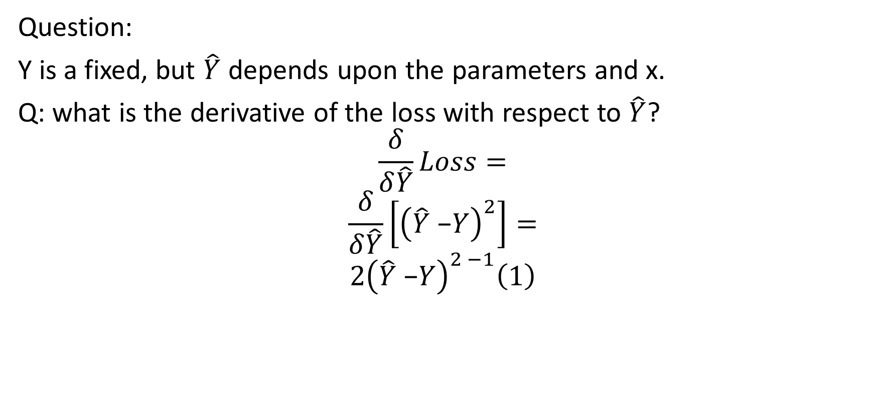
Linear regression example; (x = 2, y = 7), $B=2$, and $W$= 3, $\hat{Y}$ = 8
Question:
Y is a fixed, but $\hat{Y}$ depends upon the parameters and x.
Q: what is the derivative of the loss with respect to $\hat{Y}$?
$$\frac{δ}{δ\hat{Y}}Loss=$$
$$\frac{δ}{δ\hat{Y}}\left[{\left(\hat{Y}\text{ −}Y\right)}^{2}\right]=$$
$$2{\left(\hat{Y}\text{ −}Y\right)}^{2 −1}\left(1\right)$$

Slide 24
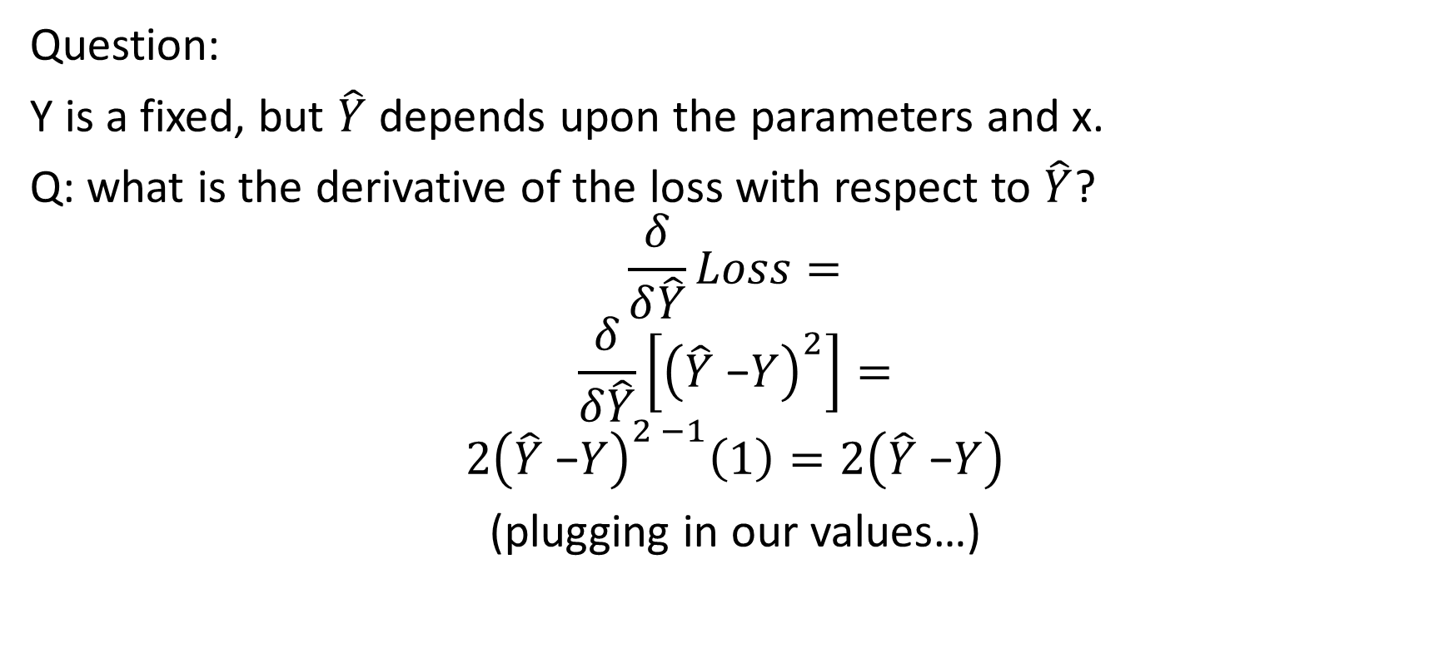
Linear regression example; (x = 2, y = 7), $B=2$, and $W$= 3, $\hat{Y}$ = 8
Question:
Y is a fixed, but $\hat{Y}$ depends upon the parameters and x.
Q: what is the derivative of the loss with respect to $\hat{Y}$?
$$\frac{δ}{δ\hat{Y}}Loss=$$
$$\frac{δ}{δ\hat{Y}}\left[{\left(\hat{Y}\text{ −}Y\right)}^{2}\right]=$$
$$2{\left(\hat{Y}\text{ −}Y\right)}^{2 −1}\left(1\right)=2\left(\hat{Y}\text{ −}Y\right)$$
(plugging in our values…)

Slide 25
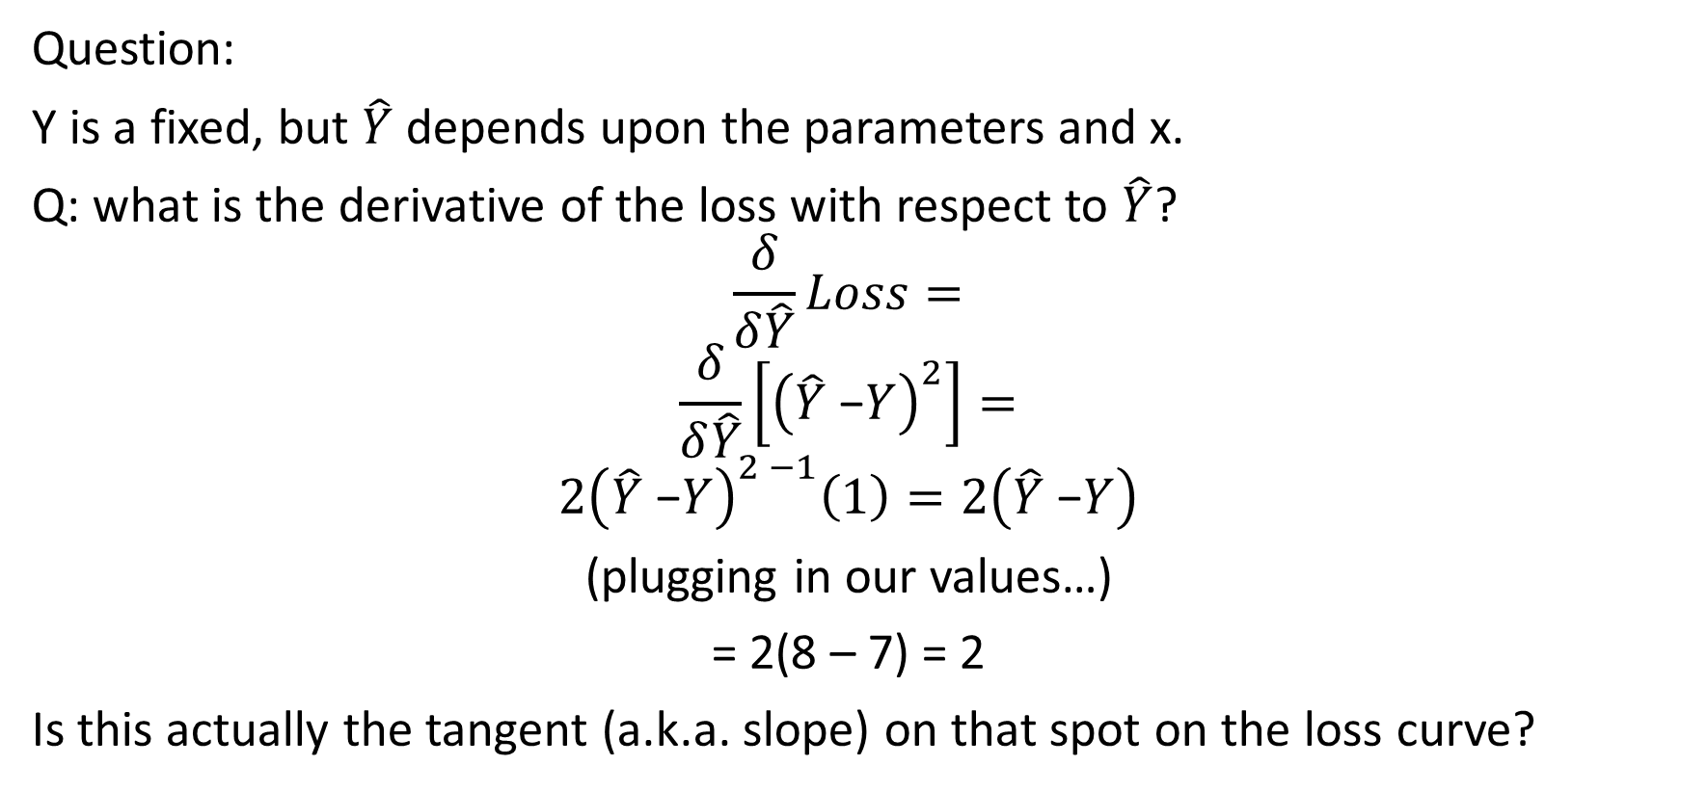
Linear regression example; (x = 2, y = 7), $B=2$, and $W$= 3, $\hat{Y}$ = 8
Question:
Y is a fixed, but $\hat{Y}$ depends upon the parameters and x.
Q: what is the derivative of the loss with respect to $\hat{Y}$?
$$\frac{δ}{δ\hat{Y}}Loss=$$
$$\frac{δ}{δ\hat{Y}}\left[{\left(\hat{Y}\text{ −}Y\right)}^{2}\right]=$$
$$2{\left(\hat{Y}\text{ −}Y\right)}^{2 −1}\left(1\right)=2\left(\hat{Y}\text{ −}Y\right)$$
(plugging in our values…)
= 2(8 – 7) = 2
Is this actually the tangent (a.k.a. slope) on that spot on the loss curve?

Slide 26
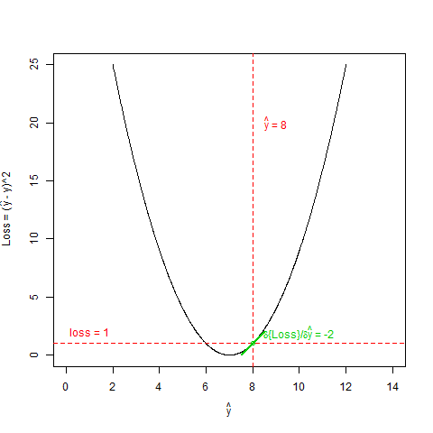
Linear regression example; (x = 2, y = 7), $B=2$, and $W$= 3, $\hat{Y}$ = 8
Yup!
Let’s add this to our graphical flow chart so we can go backpropagate.
Notes:
Going forward you might notice that green is associated with gradients; whereas red is used for passed values, (often called activations).

Slide 27
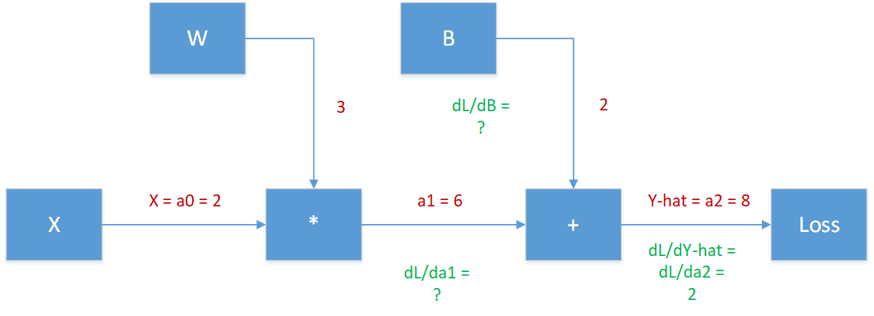
Linear regression example; (x = 2, y = 7), $B=2$, and $W$= 3, $\hat{Y}$ = 8
How might one go about calculating $\frac{δLoss}{δB}$ and $\frac{δLoss}{δa1}$?

Slide 28
CHAIN RULE!!!!

Slide 29
Linear regression example; (x = 2, y = 7), $B=2$, and $W$= 3, $\hat{Y}$ = 8
f(x, c) = x + c
f(a1,B)
What does the Chain Rule say $\frac{δLoss}{δB}$ and $\frac{δLoss}{δa1}$?
Notes:
The lowercase ‘A’ stands for ‘activation’

Slide 30
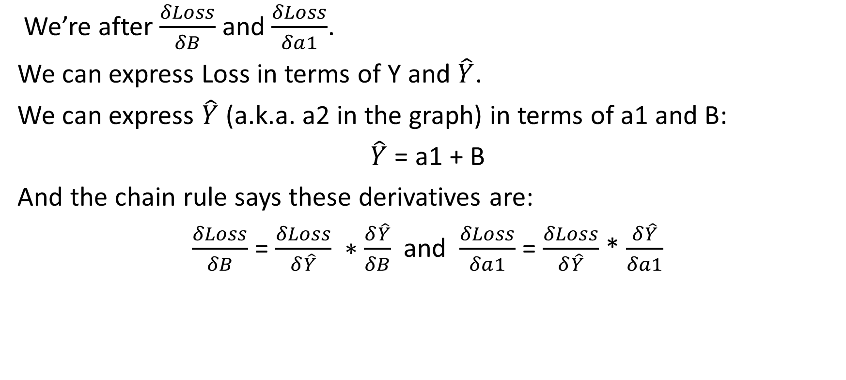
Linear regression example; (x = 2, y = 7), $B=2$, and $W$= 3, $\hat{Y}$ = 8
We’re after $\frac{δLoss}{δB}$ and $\frac{δLoss}{δa1}$.
We can express Loss in terms of Y and $\hat{Y}$.
We can express $\hat{Y}$ (a.k.a. a2 in the graph) in terms of a1 and B:
$\hat{Y}$ = a1 + B
And the chain rule says these derivatives are:
$\frac{δLoss}{δB}$ = $\frac{δLoss}{δ\hat{Y}} ∗\frac{δ\hat{Y}}{δB}$ and $\frac{δLoss}{δa1}$ = $\frac{δLoss}{δ\hat{Y}}$ * $\frac{δ\hat{Y}}{δa1}$

Slide 31
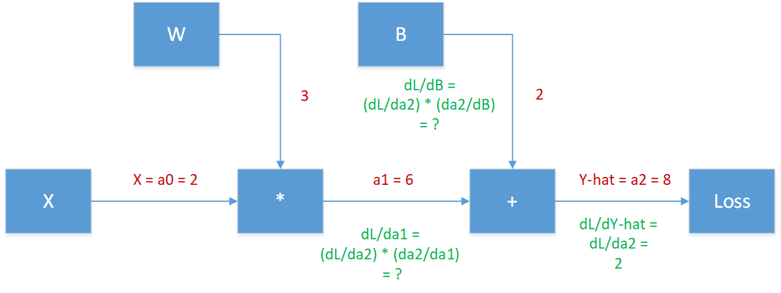
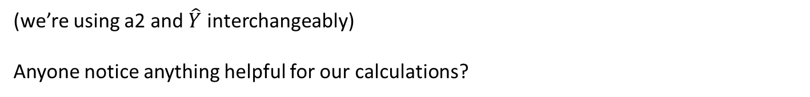
Linear regression example; (x = 2, y = 7), $B=2$, and $W$= 3, $\hat{Y}$ = 8
(we’re using a2 and $\hat{Y}$ interchangeably)
Anyone notice anything helpful for our calculations?

Slide 32
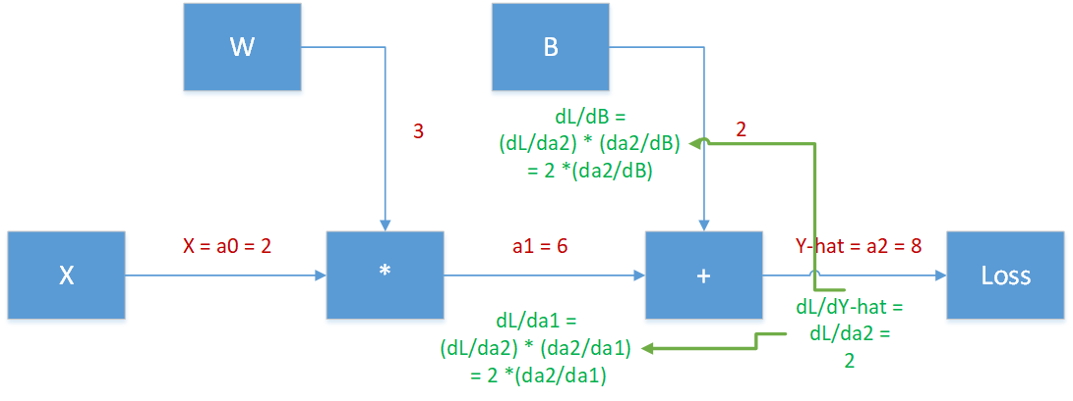
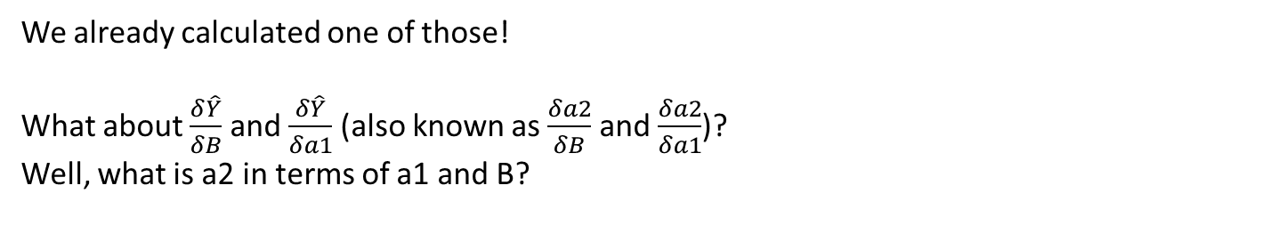
Linear regression example; (x = 2, y = 7), $B=2$, and $W$= 3, $\hat{Y}$ = 8
a2 = f(a1, b) = a1 + c
We already calculated one of those!
What about $\frac{δ\hat{Y}}{δB}$ and $\frac{δ\hat{Y}}{δa1}$ (also known as $\frac{δa2}{δB}$ and $\frac{δa2}{δa1}$)?
Well, what is a2 in terms of a1 and B?

Slide 33

Linear regression example; (x = 2, y = 7), $B=2$, and $W$= 3, $\hat{Y}$ = 8
a2 = a1 + B
What is $\frac{δ}{δa1}\left[a2\right]$
What is $\frac{δ}{δB}\left[a2\right]$

Slide 34

Linear regression example; (x = 2, y = 7), $B=2$, and $W$= 3, $\hat{Y}$ = 8
a2 = a1 + B
What is $\frac{δ}{δa1}\left[a2\right]=\frac{δ}{δa1}\left[a1+B\right]$
What is $\frac{δ}{δB}\left[a2\right]=\frac{δ}{δB}\left[a1+B\right]$

Slide 35

Linear regression example; (x = 2, y = 7), $B=2$, and $W$= 3, $\hat{Y}$ = 8
a2 = a1 + B
What is $\frac{δ}{δa1}\left[a2\right]=\frac{δ}{δa1}\left[a1+B\right]=\left[1+0\right]$
What is $\frac{δ}{δB}\left[a2\right]=\frac{δ}{δB}\left[a1+B\right]=[0+1]$

Slide 36

Linear regression example; (x = 2, y = 7), $B=2$, and $W$= 3, $\hat{Y}$ = 8
a2 = a1 + B
What is $\frac{δ}{δa1}\left[a2\right]=\frac{δ}{δa1}\left[a1+B\right]=\left[1+0\right]=1$
What is $\frac{δ}{δB}\left[a2\right]=\frac{δ}{δB}\left[a1+B\right]=\left[0+1\right]=1$
Let’s plug this into out chart:

Slide 37
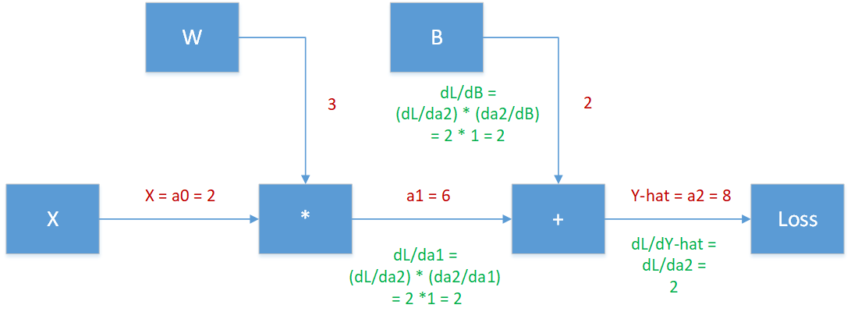

Linear regression example; (x = 2, y = 7), $B=2$, and $W$= 3, $\hat{Y}$ = 8
SUCCESS!!!
We have one of the gradients we are after! That of: $\frac{∂}{∂B}L(Y, \hat{Y})$
Let’s get the other!
What might the chain rule say about $\frac{δLoss}{δW} and\frac{δLoss}{δa0}$
Notes:
Previously, we expressed the gradient of the loss with respect to a1 in terms of the gradient of the loss with respect to a2 multiplied by the gradent of a2 with respect to a1

Slide 38

Linear regression example; (x = 2, y = 7), $B=2$, and $W$= 3, $\hat{Y}$ = 8
$\frac{δLoss}{δW}$ = $\frac{δLoss}{δa_{1}}$* $\frac{δa_{1}}{δW}$
$\frac{δLoss}{δa_{0}}$ = $\frac{δLoss}{δa_{1}}$* $\frac{δa_{1}}{δa_{0}}$
Plug it in….

Slide 39
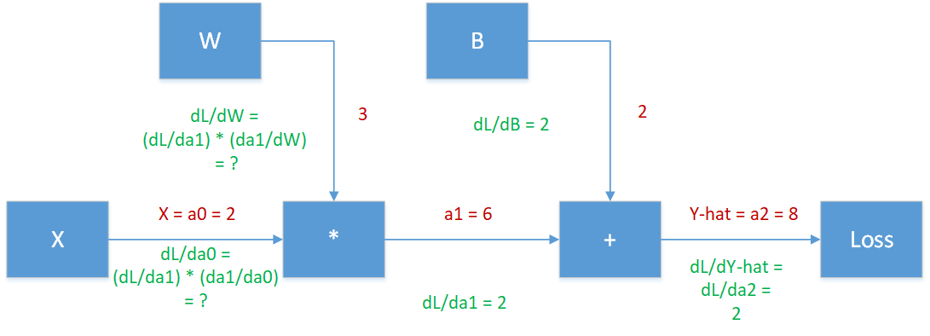
Linear regression example; (x = 2, y = 7), $B=2$, and $W$= 3, $\hat{Y}$ = 8
Does anyone see anything useful?
Notes:
Previously, we expressed the gradient of the loss with respect to a1 in terms of the gradient of the loss with respect to a2 multiplied by the gradent of a2 with respect to a1

Slide 40
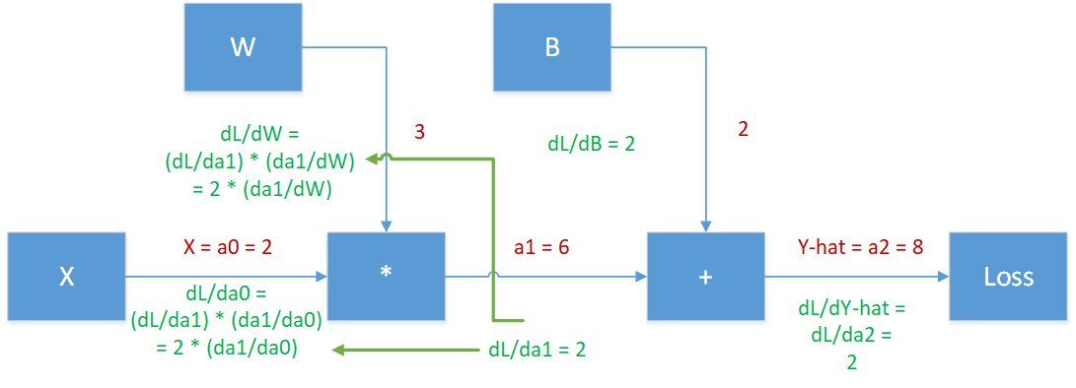
Linear regression example; (x = 2, y = 7), $B=2$, and $W$= 3, $\hat{Y}$ = 8
Can we express a1 in terms of a0 (also known as x) and W?

Slide 41

Linear regression example; (x = 2, y = 7), $B=2$, and $W$= 3, $\hat{Y}$ = 8
$a_{1}$ = $a_{0}\text{∗ }\text{W}$
What is $\frac{δ}{δa_{0}}\left[a_{1}\right]=$
What is $\frac{δ}{δW}\left[a_{1}\right]=$

Slide 42

Linear regression example; (x = 2, y = 7), $B=2$, and $W$= 3, $\hat{Y}$ = 8
$a_{1}$ = $a_{0}\text{∗ }\text{W}$
What is $\frac{δ}{δa_{0}}\left[a_{1}\right]=\frac{δ}{δa_{0}}\left[a_{0}\text{∗ }\text{W}\right]$
What is $\frac{δ}{δW}\left[a_{1}\right]=\frac{δ}{δW}\left[a_{0}\text{∗ }\text{W}\right]$

Slide 43

Linear regression example; (x = 2, y = 7), $B=2$, and $W$= 3, $\hat{Y}$ = 8
$a_{1}$ = $a_{0}\text{∗ }\text{W}$
What is $\frac{δ}{δa_{0}}\left[a_{1}\right]=\frac{δ}{δa_{0}}\left[a_{0}\text{∗ }\text{W}\right]=\left[1 ∗ W\right]$
What is $\frac{δ}{δW}\left[a_{1}\right]=\frac{δ}{δW}\left[a_{0}\text{∗ }\text{W}\right]=\left[a_{0}\text{∗ }\text{1}\right]$

Slide 44
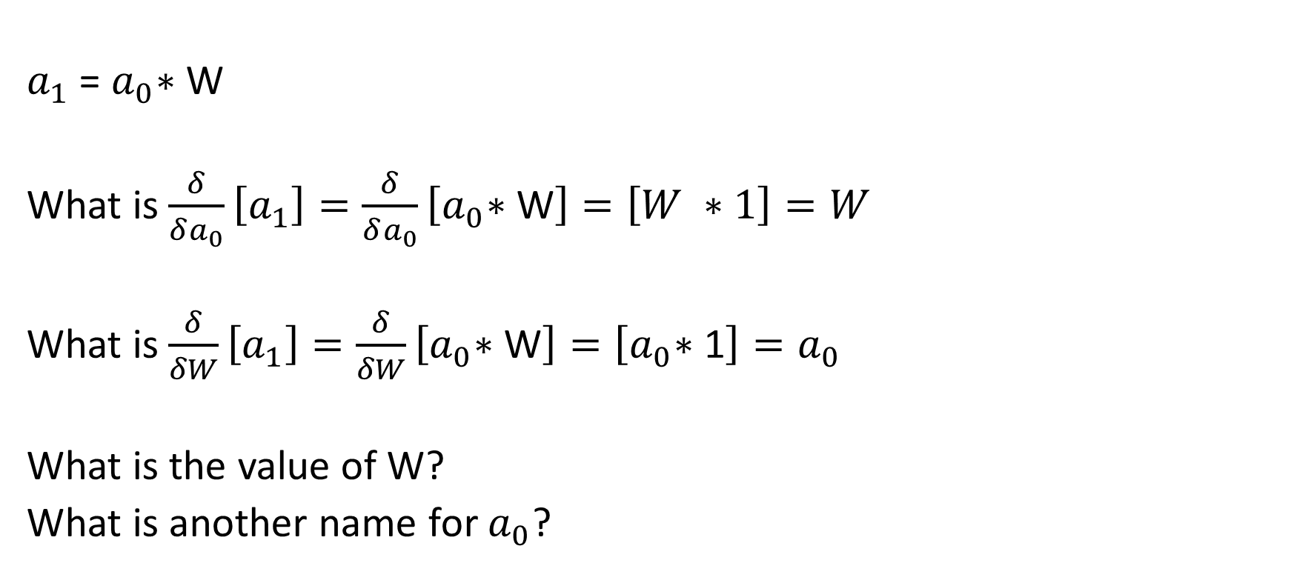
Linear regression example; (x = 2, y = 7), $B=2$, and $W$= 3, $\hat{Y}$ = 8
$a_{1}$ = $a_{0}\text{∗ }\text{W}$
What is $\frac{δ}{δa_{0}}\left[a_{1}\right]=\frac{δ}{δa_{0}}\left[a_{0}\text{∗ }\text{W}\right]=\left[W ∗1\right]=W$
What is $\frac{δ}{δW}\left[a_{1}\right]=\frac{δ}{δW}\left[a_{0}\text{∗ }\text{W}\right]=\left[a_{0}\text{∗ }\text{1}\right]=a_{0}$
What is the value of W?
What is another name for $a_{0}$?

Slide 45

Linear regression example; (x = 2, y = 7), $B=2$, and $W$= 3, $\hat{Y}$ = 8
$a_{1}$ = $a_{0}\text{∗ }\text{W}$
What is $\frac{δ}{δa_{0}}\left[a_{1}\right]=\frac{δ}{δa_{0}}\left[a_{0}\text{∗ }\text{W}\right]=\left[W ∗1\right]=W=3$
What is $\frac{δ}{δW}\left[a_{1}\right]=\frac{δ}{δW}\left[a_{0}\text{∗ }\text{W}\right]=\left[a_{0}\text{∗ }\text{1}\right]=a_{0}$ = x = 2
Let’s plug this into out chart:

Slide 46
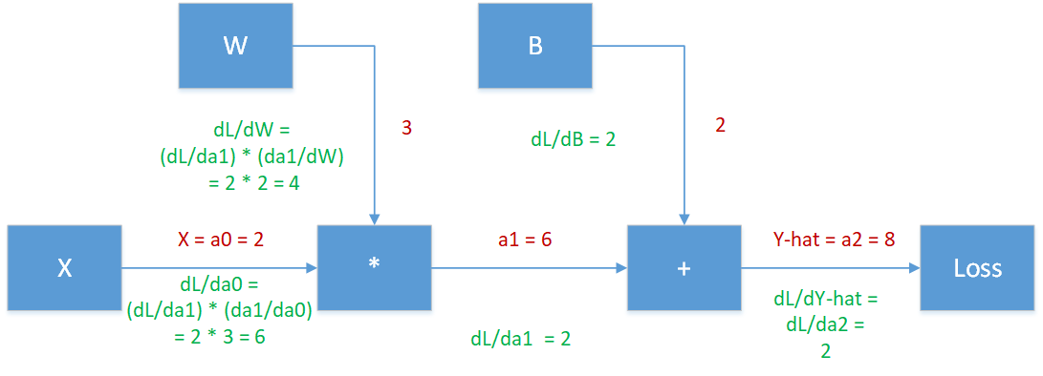
Linear regression example; (x = 2, y = 7), $B=2$, and $W$= 3, $\hat{Y}$ = 8
Double success!
We have all of the gradients we need.
Now what?

Slide 47
Linear regression example; (x = 2, y = 7), $B=2$, and $W$= 3, $\hat{Y}$ = 8
What was the ultimate goal for regression again? What are we looking for?

Slide 48
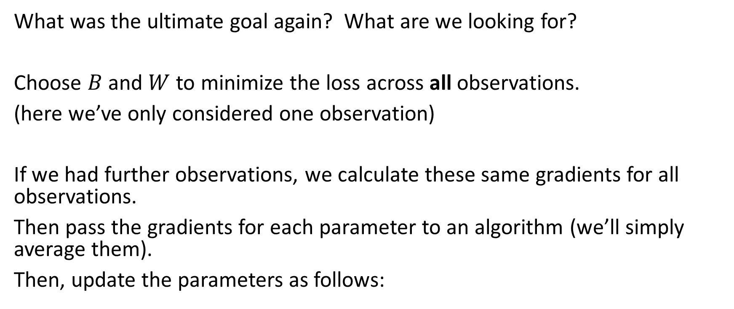
Linear regression example; (x = 2, y = 7), $B=2$, and $W$= 3, $\hat{Y}$ = 8
What was the ultimate goal again? What are we looking for?
Choose $B$ and $W$ to minimize the loss across all observations.
(here we’ve only considered one observation)
If we had further observations, we calculate these same gradients for all observations.
Then pass the gradients for each parameter to an algorithm (we’ll simply average them).
Then, update the parameters as follows:

Slide 49
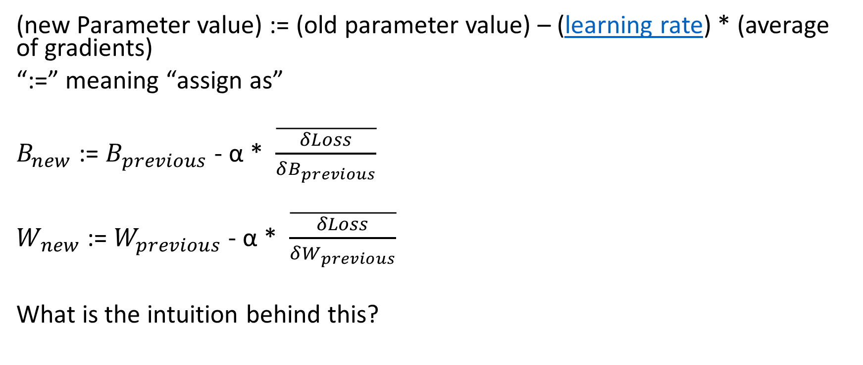
Linear regression example; Updating parameter values:
(new Parameter value) := (old parameter value) – (learning rate) * (average of gradients)
“:=” meaning “assign as”
$B_{new}$ := $B_{previous}$ - α * $\overline{\frac{δLoss}{δB_{previous}}}$
$W_{ new}$ := $W_{previous}$ - α * $\overline{\frac{δLoss}{δW_{previous}}}$
What is the intuition behind this?
Notes:
The learning rate is a hyper parameter

Slide 50
Linear regression example; Updating parameter values—What’s the intuition:
We want the loss to be as low as possible.
We get to choose our parameter values.
What direction do we want this particular y-hat to go to minimize the loss for this observation?
Notes:
We want the loss to be low, yes?

Slide 51
Linear regression example; Updating parameter values--Intuition:
We want the loss to be as low as possible.
We get to choose our parameter values.
What direction do we want this particular y-hat to go to minimize the loss for this observation?
Gradient descent indicates the direction to move parameters to move the y-hat.
Notes:
We want the loss to be low, yes?

Slide 52
Linear regression example; Updating parameter values--Intuition:
We want the loss to be as low as possible.
We get to choose our parameter values.
What direction do we want this particular y-hat to go to minimize the loss for this observation?
Gradient descent indicates the direction to move parameters to move the y-hat.
Why do we take the average?
What is good for one observation is not necessarily good for all observations.
Notes:
We want the loss to be low, yes?

Slide 53
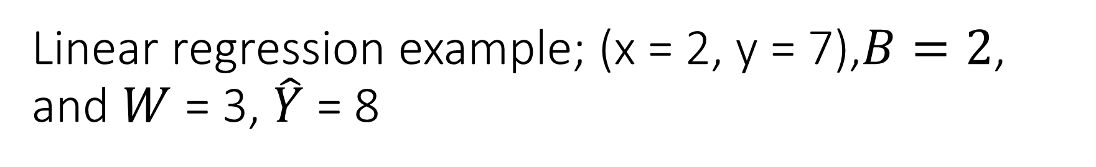
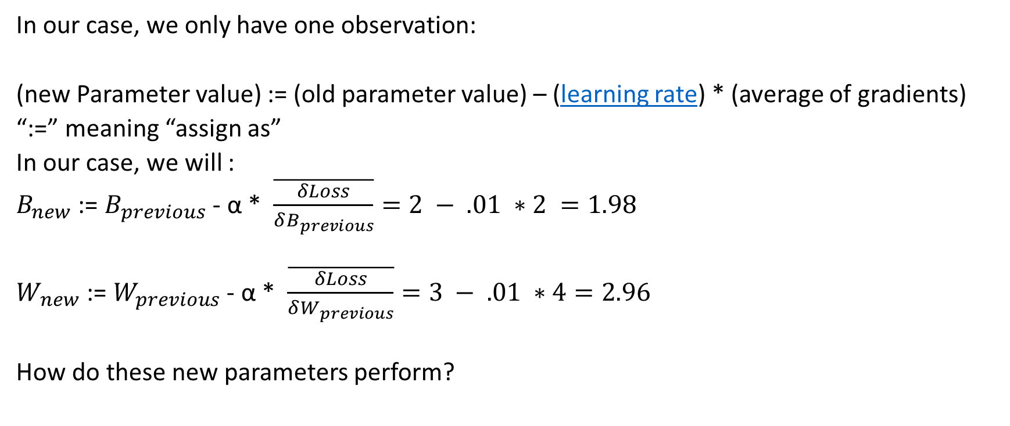
Linear regression example; (x = 2, y = 7),$B=2$, and $W$= 3, $\hat{Y}$ = 8
In our case, we only have one observation:
(new Parameter value) := (old parameter value) – (learning rate) * (average of gradients)
“:=” meaning “assign as”
In our case, we will :
$B_{new}$ := $B_{previous}$ - α * $\overline{\frac{δLoss}{δB_{previous}}}=2 − .01 ∗2 =1.98$
$W_{ new}$ := $W_{previous}$ - α * $\overline{\frac{δLoss}{δW_{previous}}}=3 − .01 ∗4=2.96$
How do these new parameters perform?

Slide 54

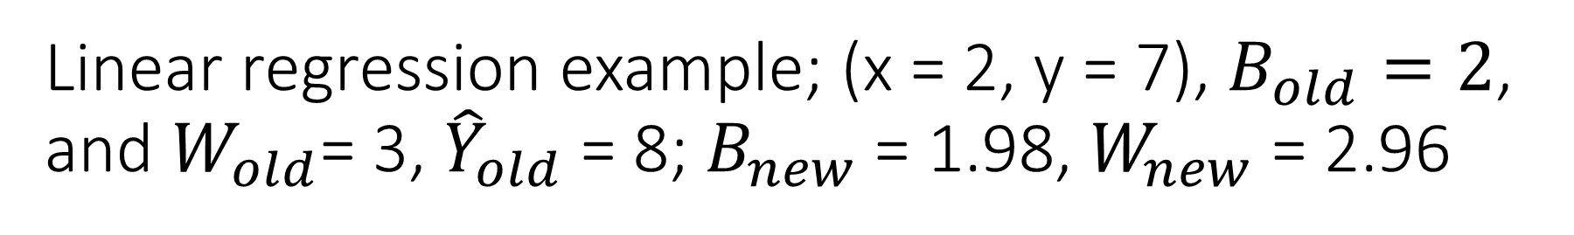
Linear regression example; (x = 2, y = 7), $B_{old}=2$, and $W_{old}$= 3, ${\hat{Y}}_{old}$ = 8; $B_{new}$ = 1.98, $W_{new}$ = 2.96
${\hat{Y}}_{new }= B_{new}$ + $W_{new}$ * X = 1.98 + 2.96 * 2 = 7.9
Closer to the actual Y than the ${\hat{Y}}_{old}$
And the new loss is lower, too.

Slide 55
Repeat ad nauseum
The idea behind gradient descent is to repeat these steps over and over until the decreases in the loss are sufficiently small.
Propagate forward and calculate loss.
Backpropagate to calculate gradients of loss with respect to all parameters for all observations.
Average gradients across all observations.
Update all parameter values at the same time.
Each cycle of these is called an epoch.
What does this look like in practice?
(switch to r)

Slide 56
But where are the neural networks?
We’re almost there.
Also, why would we ever use gradient descent / backpropagation?
Consider the (slightly different) following model.

Slide 57
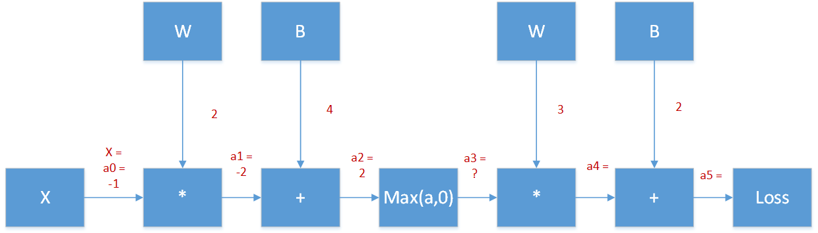
Another Model for your consideration (X = -1, Y = 7)
Activations in red

Slide 58
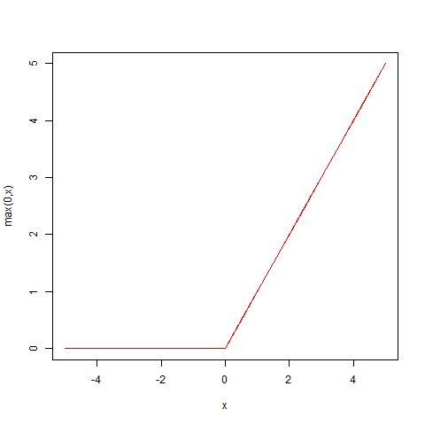
Another Model for your consideration (X = -1, Y = 7)
Max(x,0) =
0, if x < 0
x, if x > 0

Slide 59

Another Model for your consideration (X = -1, Y = 7)
Activations in red
We have a Y-hat! (it equals 8)
We also have a loss of: (8 – 7) ^2 = 1
Does anyone recognize the right half of the model?

Slide 60

Another Model for your consideration (X = -1, Y = 7)
What is $\frac{δ Loss}{δ a2}$?

Slide 61
Another Model for your consideration (X = -1, Y = 7)
Activations in red
What is $\frac{δ Loss}{δ a2}$? Hint: $We already know \frac{δ Loss}{δ a3}$ (it equals 6)

Slide 62

Another Model for your consideration (X = -1, Y = 7)
Activations in red
Okay, what’s the local gradient?

Slide 63
Another Model for your consideration (X = -1, Y = 7)
Max(x,0) =
0, if x < 0
x, if x > 0
What is the derivative?

Slide 64

Another Model for your consideration (X = -1, Y = 7)
Max(x,0) =
0, if x < 0
x, if x > 0
What is the derivative?
$$\frac{δ}{δx}\max\left(0,x\right)=$$
0, if x < 0
1, if x > 0

Slide 65
Another Model for your consideration (X = -1, Y = 7)
Activations in red
Is the value going into the max function greater or less than zero?
What’s the local gradient?

Slide 66

Another Model for your consideration (X = -1, Y = 7)
Activations in red
f(x, c) = x + c
f(a1,B) = a1 + B

Slide 67

Another Model for your consideration (X = -1, Y = 7)
Activations in red
g(x,d) = x * d
g(a0,W) = a0 * W

Slide 68

Another Model for your consideration (X = -1, Y = 7)
And we’re done. We can update the parameter values as we did with linear regression.

Slide 69

Another Model for your consideration (X = -1, Y = 7)
Does anyone want to recognize this model?

Slide 70

Another Model for your consideration (X = -1, Y = 7)
It’s a very simple fully connected neural network.

Slide 71

Another Model for your consideration (X = -1, Y = 7)
It, also, might appear as follows (the extra nodes represents the intercept(s) a.k.a. bias(es))
1
1

Slide 72

Big takeaway
Neural Networks are nothing more than a series of differentiable composite functions.
This last one is:
$$\hat{Y}=f(g(\max\left(f\left(g\left(X,W1\right),B1\right),0\right),W2),B2)$$

Slide 73
Other things to learn
This is only touching on Fully Connected Neural Networks
Variance/bias trade-off a.k.a. overfit/underfit
Regularization
Parameter initialization
Batch gradient descent
Exploding/vanishing gradient
Dropout
Etc.
Other types of NN
Convolutional Neural Networks
Recurrent Neural Networks

Slide 74
Resources
Andrew Ng's coursera classes on neural networks
Andrej Karpathy’s recorded class on Convolutional Neural Networks
Notes
video lectures

